Slide 1

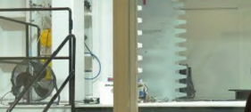
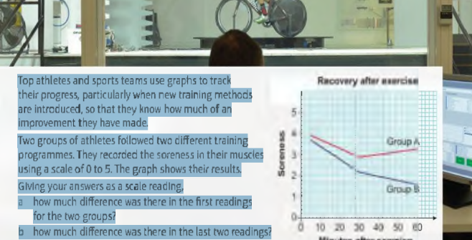
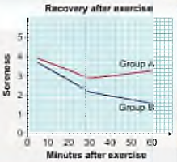
Mathematics (9-1) - iGCSE
2018-20
Year 09
Top athletes and sports teams use graphs to track their progress, particularly when new training methods are introduced, so that they know how much of an improvement they have made.
Two groups of athletes followed two different training programs. They recorded the soreness in their muscles using a scale of 0 to 5. The graph shows their results.
Giving your answers as a scale reading, a how much difference was there in the first readings for the two groups?
how much difference was there in the last two readings?
Which group had the better training session?
Unit 6 – Graphs

Slide 2
Contents
Page iv
6 Graphs 121
Prior knowledge check 159
6.1 Linear graphs 161
6.2 More linear graphs 164
6.3 Graphing rates of change 166
6.4 Real-life graphs 170
6.5 Line segments 174
6.6 Quadratic graphs 176
6.7 Cubic and reciprocal graphs 180
6.8 More graphs 182
Problem-solving 186
Check up 187
Strengthen 190
Extend 195
Knowledge check 198
Unit test 200

Slide 3
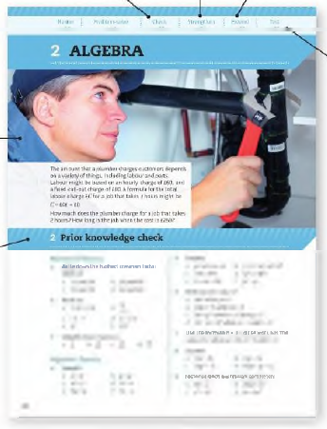
Contents
Page v
At the end of the Master lessons, take a check-up test to help you to decide whether to strengthen or Extend our learning
Extend helps you to apply the maths you know to some different situations
Unit Openers put the maths you are about to learn into a real-life context. Have a go at the question - it uses maths you have already learnt so you should be able to answer it at the start of the unit.
When you have finished the whole unit, a Unit test helps you see how much progress you are making.
Choose only the topics in strengthen thay you need a bit more practice with. You’ll find more hints here to lead you through specific questions. Then move on to Extend
Use the Prior knowledge check to make sure you are ready to start the main lessons in the unit. It checks your knowledge from Key Stage 3 and from earlier in the GCSE course. Your teacher has access to worksheets if you need to recap anything.

Slide 4
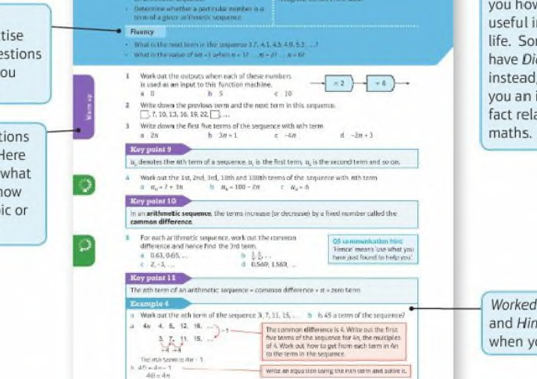
Contents
Page vi

Slide 5
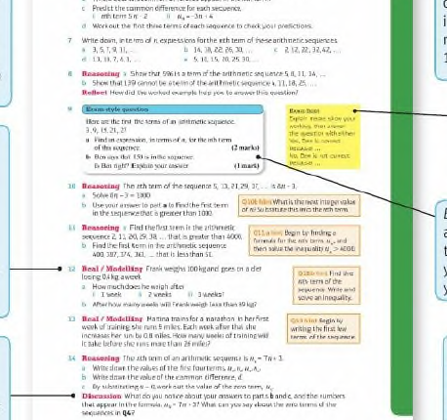
Contents
Page vi

Slide 6
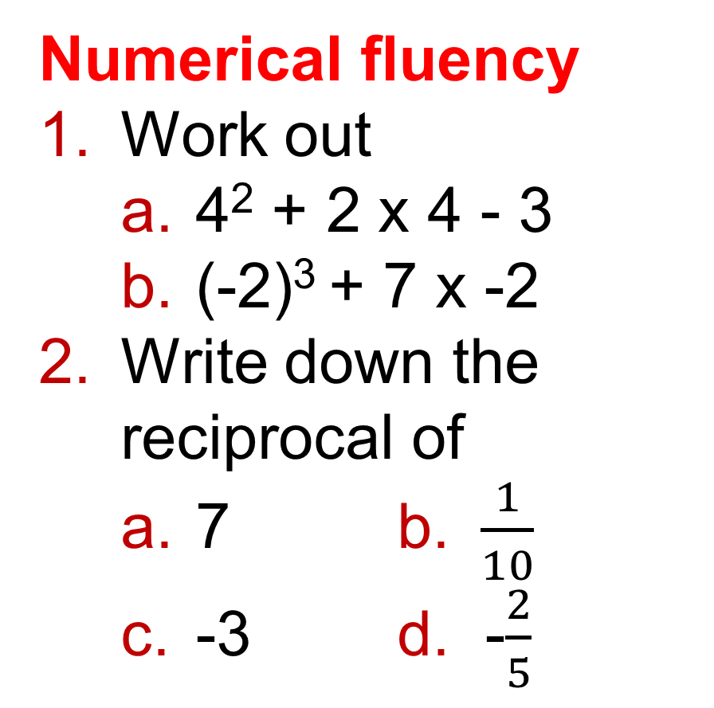
6 – Prior Knowledge Check
Page 159
Numerical fluency
Work out
  4² + 2 x 4 - 3
  (-2)³ + 7 x -2
Write down the reciprocal of
  7 b. $\frac{1}{10}$
  -3 d. -$\frac{2}{5}$

Slide 7

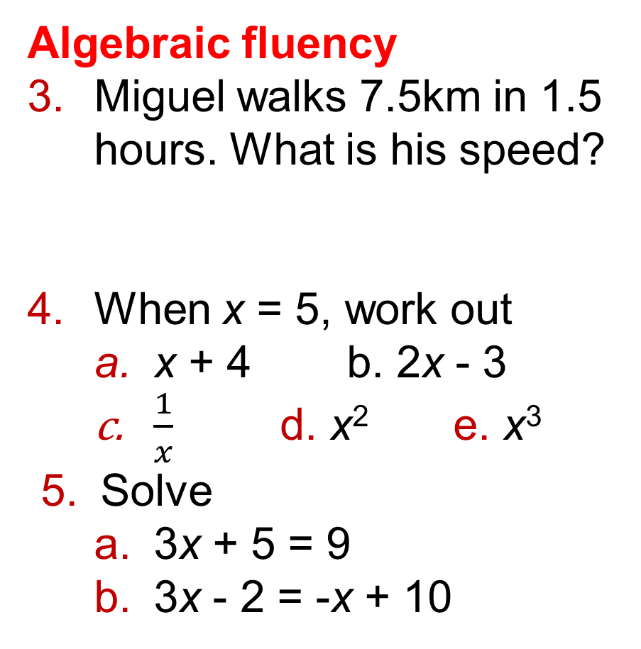
6 – Prior Knowledge Check
Page 159
Algebraic fluency
Miguel walks 7.5km in 1.5 hours. What is his speed?
When x = 5, work out
  x + 4 b. 2x - 3
  $\frac{1}{x}$ d. x² e. x³
Solve
  3x + 5 = 9
  3x - 2 = -x + 10
Q3 hint – Speed = $\frac{Distance}{Time}$

Slide 8
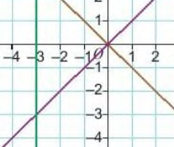
6 – Prior Knowledge Check
Page 159
Graphical fluency
Write down the equation for each line.

Slide 9
6 – Prior Knowledge Check
Page 160
Graphical fluency
a Copy and complete the table of values for:
y = 2x + 1.
Plot the graph of
y = 2x + 1.
x | -3 | -2 | -1 | 0 | 1 | 2 | 3
y

Slide 10
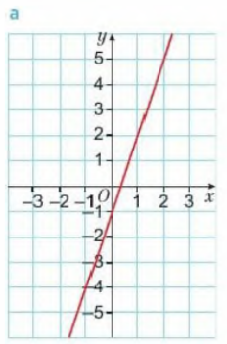
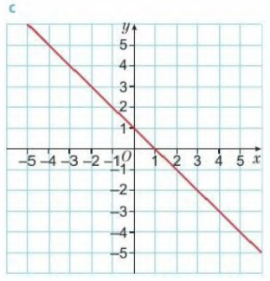
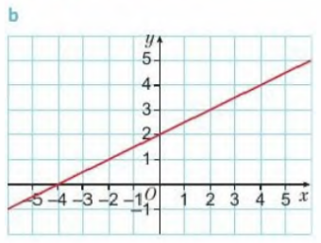
6 – Prior Knowledge Check
Page 160
Graphical fluency
For each of these graphs, work out
  the gradient
  the y-intercept.

Slide 11
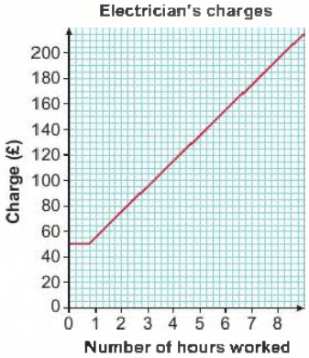
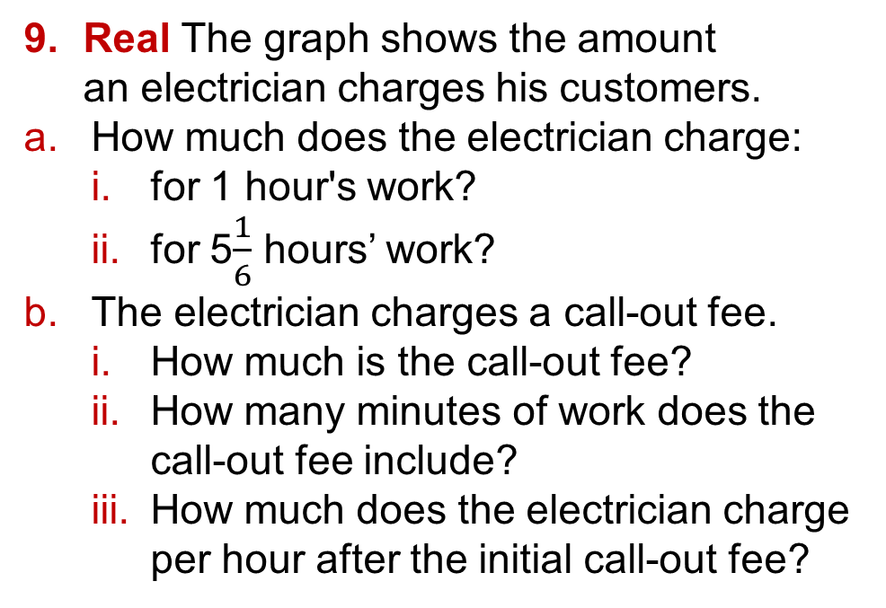
6 – Prior Knowledge Check
Page 160
Real The graph shows the amount
an electrician charges his customers.
How much does the electrician charge:
  for 1 hour's work?
  for 5$\frac{1}{6}$ hours’ work?
The electrician charges a call-out fee.
  How much is the call-out fee?
  How many minutes of work does the call-out fee include?
  How much does the electrician charge per hour after the initial call-out fee?

Slide 12
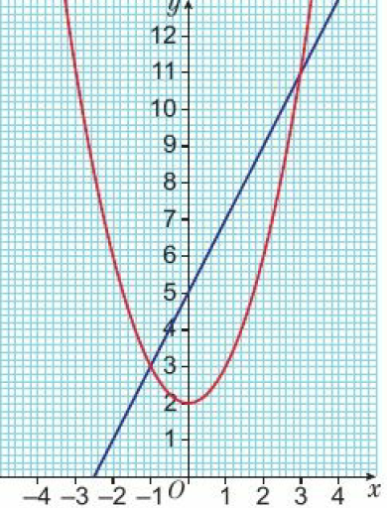
6 – Prior Knowledge Check
Page 160
* Challenge
The graphs of y = x² + 2 and
y = 2x + 5 are plotted on the grid.
Give the coordinates of the two points of intersection of these graphs.

Slide 13
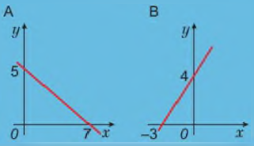
6.1 – Linear graphs
Page 160
Objectives |  | Why learn this?
Find the gradient and y-intercept from a linear equation. Rearrange an equation into the form y = mx + c. Compare two graphs from their equations. Plot graphs with equations ax + by = c. |  | You can use linear graphs to show how two values are related, like converting money from pounds to dollars.
Fluency
Which graph has positive gradient? Which has negative? What are the x- and y- intercepts of each graph? 1
ActiveLearn - Homework, practice and support: Higher 6.1

Slide 14

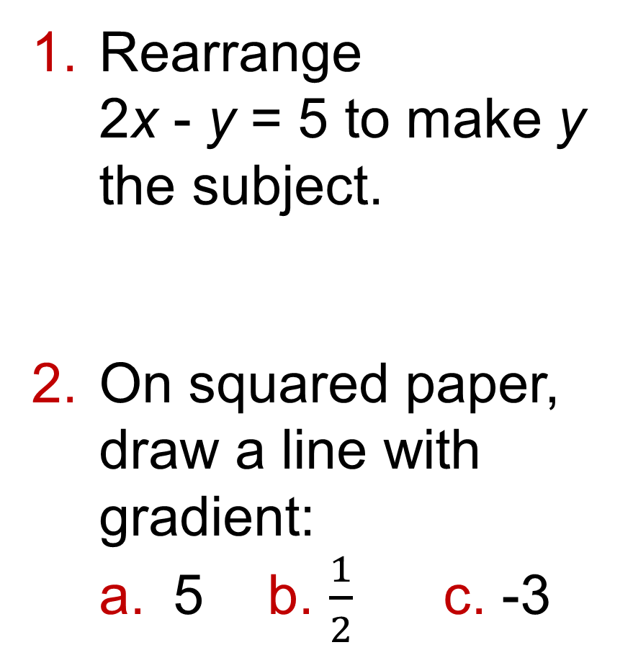
6.1 – Linear graphs
Page 161
Rearrange
2x - y = 5 to make y the subject.
On squared paper, draw a line with gradient:
  5 b. $\frac{1}{2}$ c. -3
Warm Up
Questions in this unit are targeted at the steps indicated.

Slide 15
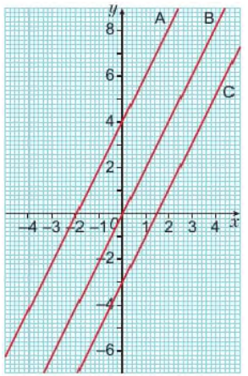

6.1 – Linear graphs
Page 161
Copy and complete this table for the graphs on the grid.
Discussion
How can you find the gradient and the y-intercept from the equation of a line?
Equation of Line | Gradient | y-intercept
y = 2x + 4
y = 2x
y = 2x + 3
ActiveLearn - Homework, practice and support: Higher 6.1

Slide 16
6.1 – Linear graphs
Page 182
Key Point 1
A linear equation generates a straight-line (linear) graph.
The equation for a straight-line graph can be written as y = mx + c where m is the gradient and c is the y-intercept.
Example 1
Write the equation of
line A b. line B
y – mx + c
gradient m = 2
y-intercept is (0, -8), so c = -8
Equation of line A is y = 2x - 8
y = mx + c
gradient m = -3
y-intercept is (0, 2), so c = 2
Equation of line B is y = -3x + 2
Write down the formula
Workout the gradient from points on the
line. Find the y-intercept.
Substitute the values into the formula.

Slide 17
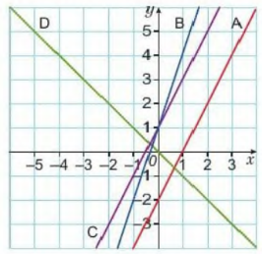
6.1 – Linear graphs
Page 162
a. Match each
line to an
equation:
Which line passes through the origin?
Which line is steepest?
Which lines have the same intercept?
Which lines are parallel?
y = -x
y = 3x +1
y = 2x +1
y = 2x -2
y = 2x - 4
Q4 communication hint – The origin is the point (0, 0).
Q4e hint – Parallel lines have the same gradient.

Slide 18

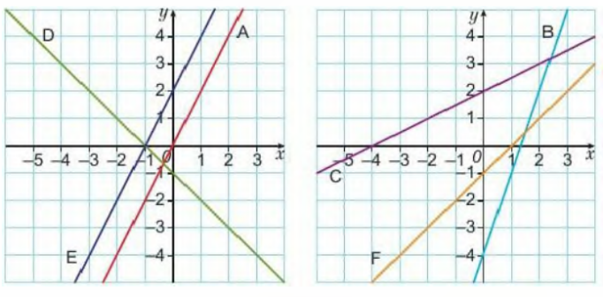
6.1 – Linear graphs
Page 163
Write the equations of these lines.
Q5 hint – Read the scale of both axes carefully.

Slide 19
6.1 – Linear graphs
Page 163
Here are the equations of some linear graphs. Which of these graphs:
  cross the y-axis at the same point
  are parallel?
    y = 2x - 3 ii. y = 3x + 1
    y = x - 1 iv. y = 2x + 1
    y = -x
Key Point 2
To find the y-intercept of a graph, find the y-coordinate where x = 0.
To find the x-intercept of a graph, find the y-coordinate where y = 0.

Slide 20
6.1 – Linear graphs
Page 163
a. For the equation 2y - x = 3
    copy and complete the table of values
    plot the graph on suitable axes.
  Repeat part a for the lines with equation:
    x + y = b ii. x + y = 7
    Discussion Where do you think the graph of x + y = 3 will cross the axes?
    Where will x + y = -1?
x | 0
y |  | 0
Q7a i hint - When x = 0, what is the value of y?

Slide 21
6.1 – Linear graphs
Page 163
In Q7 you drew the graphs of 2y - x = 3, x + y = 4 and x + y = 7.
  Rearrange each equation to make y the subject.
  Read the gradients and y-intercepts from each.
  Look back at your graphs in Q7 to check the gradients and y-intercepts are correct.
Key Point 3
To compare the gradients and y-intercepts of two straight lines, make sure their equations are in the form y = mx + c.

Slide 22
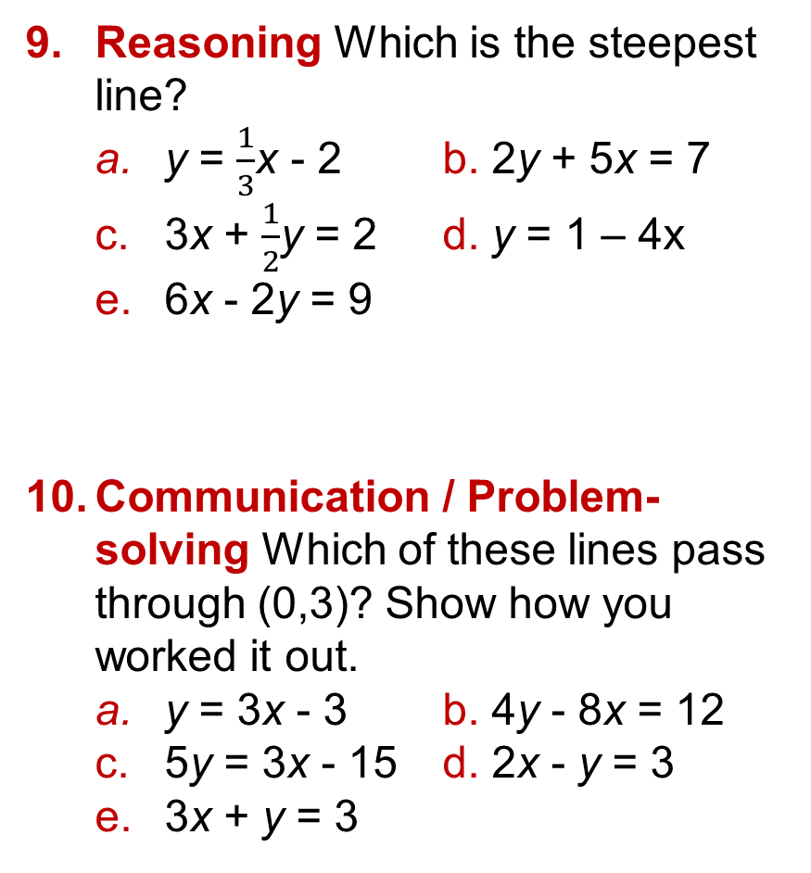
6.1 – Linear graphs
Page 163
Reasoning Which is the steepest line?
  y = $\frac{1}{3}$x - 2 b. 2y + 5x = 7
  3x + $\frac{1}{2}$y = 2 d. y = 1 – 4x
  6x - 2y = 9
Communication / Problem-solving Which of these lines pass through (0,3)? Show how you worked it out.
  y = 3x - 3 b. 4y - 8x = 12
  5y = 3x - 15 d. 2x - y = 3
  3x + y = 3
Q9 hint - Rearrange to y = mx + c if necessary.

Slide 23
6.2 – More Linear graphs
Page 164
Objectives |  | Did You Know?
Sketch graphs using the gradient and intercepts. Find the equation of a line, given its gradient and one point on the line. Find the gradient of a line through two points. |  | You can plot a straight-line graph using just the gradient and intercept – you don’t have to work out a table of values.
Fluency
Which lines are parallel? Which have the same y-intercept? y = 3x + 1 • y = -x + 1 • y = x + 2 • y = 5 - x
ActiveLearn - Homework, practice and support: Higher 6.2

Slide 24
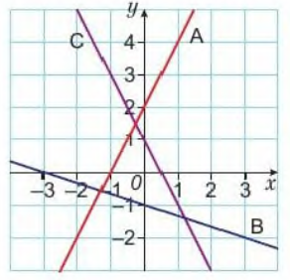
6.2 – More Linear graphs
Page 164
Write an equation for each line.
The equation of a line is y = 3x + c. Find the value of c when x is 4 and y is 15.
Warm Up

Slide 25
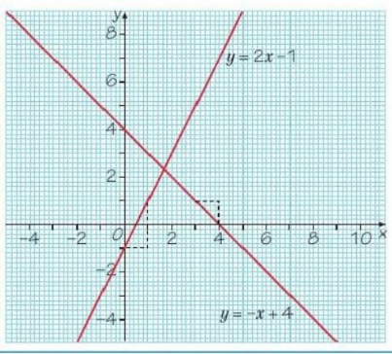
6.2 – More Linear graphs
Page 164
Example 2
On the same grid, draw these
graphs from their equations.
y = 2x – 1
y = -x +4
Plot the y-intercept.
Decide if the gradient is positive or negative.
Draw a line with this gradient, starting from the y-intercept.
Extend your line right across the grid.
Label the lone with its equation.
ActiveLearn - Homework, practice and support: Higher 6.2

Slide 26
6.2 – More Linear graphs
Page 165
Draw these graphs from their equations.
Use a coordinate grid from -10 to +10 on both axes,
  y = 2x + 4 b. y = 2x - 3
  y = 3x d. y = ½x + 2
  y = -2x + 1 f. y = -3x + 2
Sketch the graphs of
  y = 2x b. y = 3x + 1
  x + y = 5
Q5 hint - Find the x- and y-intercepts. Join them with a straight line.

Slide 27
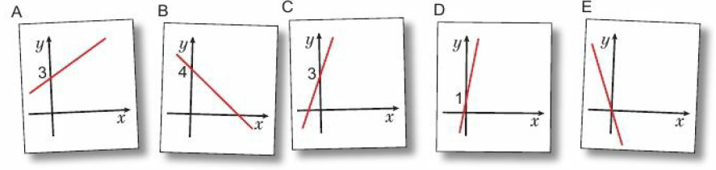
6.2 – More Linear graphs
Page 165
Reasoning Match each equation to one of these sketch graphs.
Reflect What does it mean in maths to sketch a graph? What information do you include on a sketch? How is this different from plotting a graph?
y = 5x + 1
y = ½x + 3
y = 2x + 3
y = -x + 4
y = -3x

Slide 28
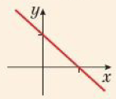
6.2 – More Linear graphs
Page 165
a. Find the re-intercept and y-intercept of the graph with equation
    x + y =3
    3x + y = -6
    y – x = 2
    y - 2x = 4
  Sketch the graphs.
Q6 hint - Mark the x-
and y-intercept and join
with a straight line.
Key Point 4
A linear function has a graph that is a straight line

Slide 29
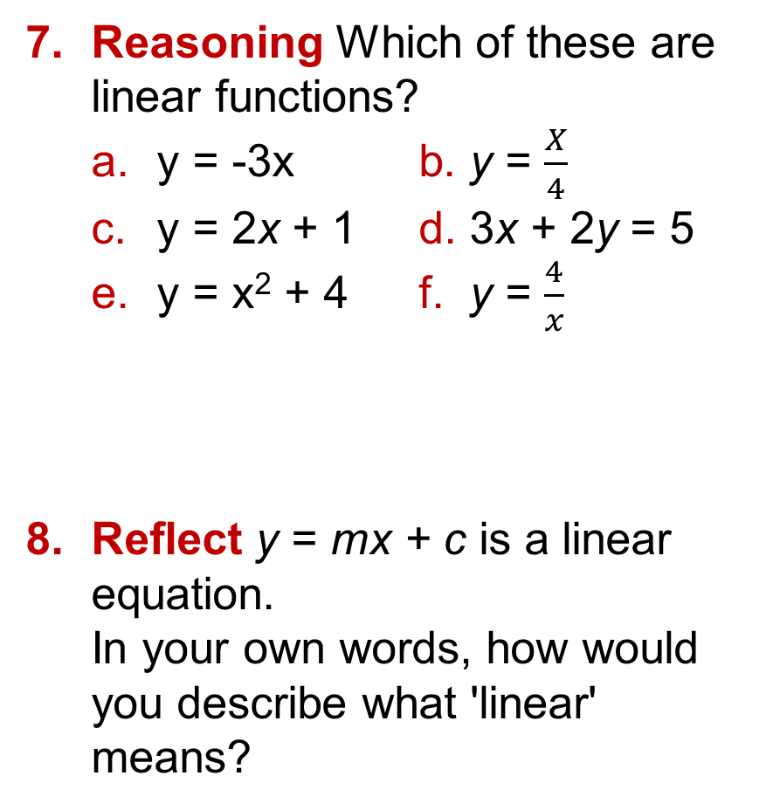
6.2 – More Linear graphs
Page 165
Reasoning Which of these are linear functions?
  y = -3x b. y = $\frac{X}{4}$
  y = 2x + 1 d. 3x + 2y = 5
  y = x² + 4 f. y = $\frac{4}{x}$
Reflect y = mx + c is a linear equation.
In your own words, how would you describe what 'linear' means?
Q7 hint – Can you write them as y = mx + c

Slide 30
6.2 – More Linear graphs
Page 165
Reasoning
  Does the point (3,6) lie on the line y = ½x?
  Does the point (2,9) lie on the line y = 2x + 5?
  Does the point (-2, -7) lie on the line y = -4x - 1?
Q9 hint – Substitute the values of x and y into the equation of the line.
Do both sides of the equation have the same value? What does it mean if they do? What does it mean if they do not?

Slide 31
6.2 – More Linear graphs
Page 165
Problem-solving A straight line has gradient 2. The point (4,5) lies on the line. Find the equation of the line.
Problem-solving Work out the equations of these straight-line graphs,
  The line with gradient 3 that passes through the point (0,5)
  The line with gradient -1 that passes through the point (3,0)
  The line with gradient j that passes through the point (6,1)
  The line with gradient -2 that passes through the point (5, -4)
Q10 strategy hint - Substitute the gradient (m) into the equation y = mx + c.
Then substitute the given values of x and y (the coordinates of the point) and solve to find c.

Slide 32

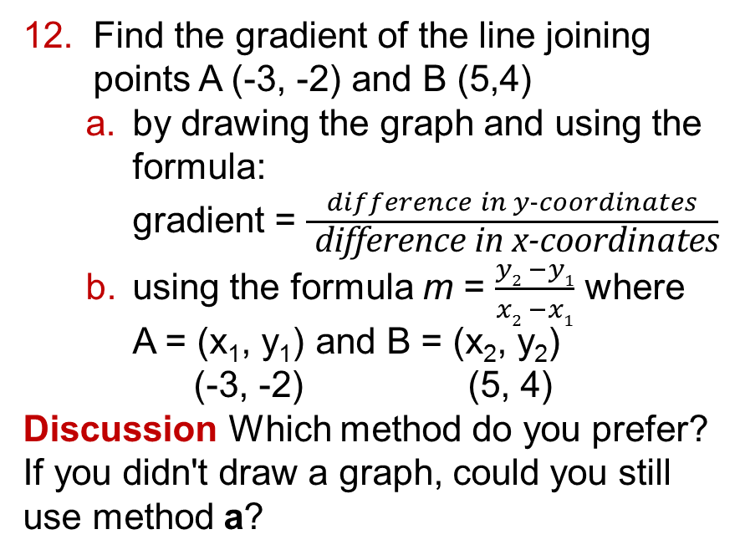
6.2 – More Linear graphs
Page 166
Find the gradient of the line joining points A (-3, -2) and B (5,4)
  by drawing the graph and using the formula:
  gradient = $\frac{difference in y−coordinates}{ \text{difference} \text{in} \text{x}\text{−}\text{coordinates}}$
  using the formula m = $\frac{y2 −y1}{x2 −x1}$ where
  A = (x₁, y₁) and B = (x₂, y₂)
  (-3, -2) (5, 4)
  Discussion Which method do you prefer? If you didn't draw a graph, could you still use method a?
Q12a hint –

Slide 33
6.2 – More Linear graphs
Page 166
Reasoning P is the point (-2,6). Q is the point (10,0).
  Find the gradient of line PQ.
  Write y = mx + c using your gradient from part a. Substitute the coordinates of Q into this equation. Solve to find c.
  Write the equation of the line PQ.
Find the coordinates of the point where these graphs intersect.
y = -x + 2 and 3x + 2y = 5
Q15 hint – Write both as y= mx + c.

Slide 34
6.2 – More Linear graphs
Page 166
To find the coordinates of the point where these graphs intersect:
y = 4x - 3 and y = -x + 12
  write the two equations equal to each other
  solve to find x
  substitute x into one of the first equations to find y
  write the coordinates (x,y)
Q14a hint – 4x - 3 = -x + 12

Slide 35
6.3 – Graphing Rates of Change
Page 166
Objectives |  | Did You Know?
Draw and interpret distance-time graphs. Calculate average speed from a distance-time graph. Understand velocity-time graphs. Find acceleration and distance from velocity-time graphs. |  | A rate of change tells us how fast something changes in a given time period. Your speed measures how fast Your position changes over time.
Fluency
A car travels 17 miles in I hour. What is its speed?
ActiveLearn - Homework, practice and support: Higher 6.3

Slide 36
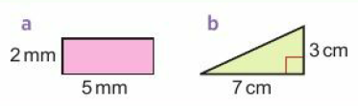
6.3 – Graphing Rates of Change
Page 166
Find the area of each shape.
Warm Up
Q1 hint – Remember to give units for your answers.
Key Point 5
A distance-time graph represents a journey. The vertical axis represents the distance from the starting point. The horizontal axis represents the time taken.

Slide 37
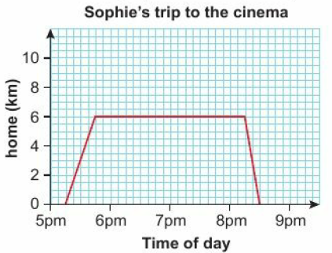
6.3 – Graphing Rates of Change
Page 167
Real Sophie drives from her house to a cinema. The
distance-time graph shows her journey.
  How far is Sophie's house
  from the cinema?
  What time does Sophie
  arrive at the cinema?
  How long does she take
  to drive to the cinema?
  How long is she at the
  cinema?
  What was her speed on
  the way to the cinema?
  Work out the gradient for her
  drive to the cinema. What do you notice?
  Discussion What does a horizontal line mean on a distance-time graph? What does the gradient mean?

Slide 38
6.3 – Graphing Rates of Change
Page 167
Key Point 6
On a distance-time graph the gradient is the speed.
Real / Modelling Amal drives to her friend's house.
She drives 150 km in 2.5 hours. Then she stops for a half-hour break.
She then drives 70 km in 1 hour and arrives at her friend's house,
  On graph paper draw a horizontal axis from 0 to 4 hours and a vertical axis from 0 to 220 km.
  Draw a distance-time graph to show Amal's journey,
  Work out her speed for the first part of the journey.

Slide 39
6.3 – Graphing Rates of Change
Page 167
Kirsty is practising speed skating.
She covers the 1200m straight course in 75 seconds. She rests for 1 minute then skates back to the start line at 10m/s.
  Draw a distance-time graph to show Kirsty’s skating practice.
  Work out the fastest speed she travelled.
Q4a hint - Work out how far Kirsty travels in 1 second, or in 10 seconds. Plot this as a point.
Q4b hint - What units do you need to use?

Slide 40
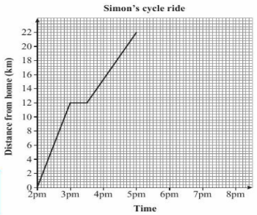
6.3 – Graphing Rates of Change
Page 168
5 – Exam-Style Questions
Simon went for a cycle ride. He left home at 2pm. The travel graph represents part of Simon’s cycle ride.
At 3pm Simon stopped for a rest,
How many minutes did he rest? (1 mark)
How far was Simon from home at 5pm?
(1 mark)
At 5pm Simon stopped for 30 minutes. Then he cycled home at a steady speed.
It took him 1 hour 30 minutes to get home.
Complete the travel graph. (2 marks)
March 2013, Q3, 1MA0/2H
Exam hint
In an examination, graphs are marked online so make sure the examiner can see your pencil drawings.
Use a pencil that is easy to see over the grid lines
Q5 communication hint - Steady speed means travelling the same distance each minute.

Slide 41
6.3 – Graphing Rates of Change
Page 168
Real / Modelling The table shows a train journey from Birmingham
to Shrewsbury. The train stops at Wolverhampton and Telford on the way.
When a train arrives at a station, it stays for 3 minutes before leaving for the next station. There are 16 miles between each pair of stations,
  Draw a distance-time graph for this journey,
  Work out the speed of the train between Birmingham and Wolverhampton,
  Work out the speed of the train between Telford and Shrewsbury,
  What was the average speed for the whole journey?
Q4b hint - Do you think the average speed for the whole journey will be faster or slower than the speed over each part of the journey? Why?
Station | Time
Birmingham New Street (departing) | 1432
Wolverhampton (arriving) | 1442
Telford (arriving) | 1459
Shrewsbury (arriving) | 1519

Slide 42
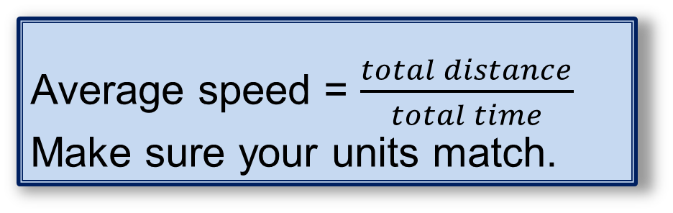
6.3 – Graphing Rates of Change
Page 168
Key Point 7
Average speed = $\frac{total distance}{total time}$
Make sure your units match.
Look at the graph you drew for Q3. What was Amal's average speed for the whole journey?
Key Point 8
The gradient of a straight line graph is the rate of change.

Slide 43
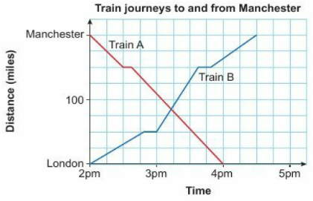
6.3 – Graphing Rates of Change
Page 169
Real / Modelling Train A travels from Manchester to London.
Train B travels from London to Manchester.
  Use the graph to estimate how far they are from London when they pass each other,
  Work out the speed for each part of the journey for Train A.
  When was Train B travelling fastest? How can you tell this from the graph?
  Which train travelled faster on average?
Discussion Are these distance-
time graphs good models for train
journeys? What assumptions have
been made?
Q8 hint – Look at the units on the graph.

Slide 44
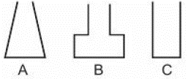
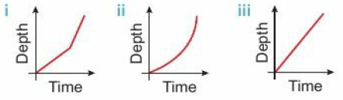
6.3 – Graphing Rates of Change
Page 169
Reasoning Josh runs water into these three containers
at a constant rate.
  In which container does the depth of water increase by the same amount every second?
  Which graph shows the depth of water increasing steadily?
  Match each graph to one container.
Discussion Why is graph ii curved?
Q9 communication hint - Constant rate means the same amount flows in every second.

Slide 45
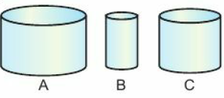
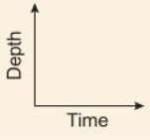
6.3 – Graphing Rates of Change
Page 169
Reasoning Here are three vases.
They are all cylinders and all the same height. Skye fills the vases with water at the same rate.
On the same axes, sketch three graphs showing the rate at which water fills the vases.
Q10 hint - Which vase will be full first? Which will be full last?

Slide 46
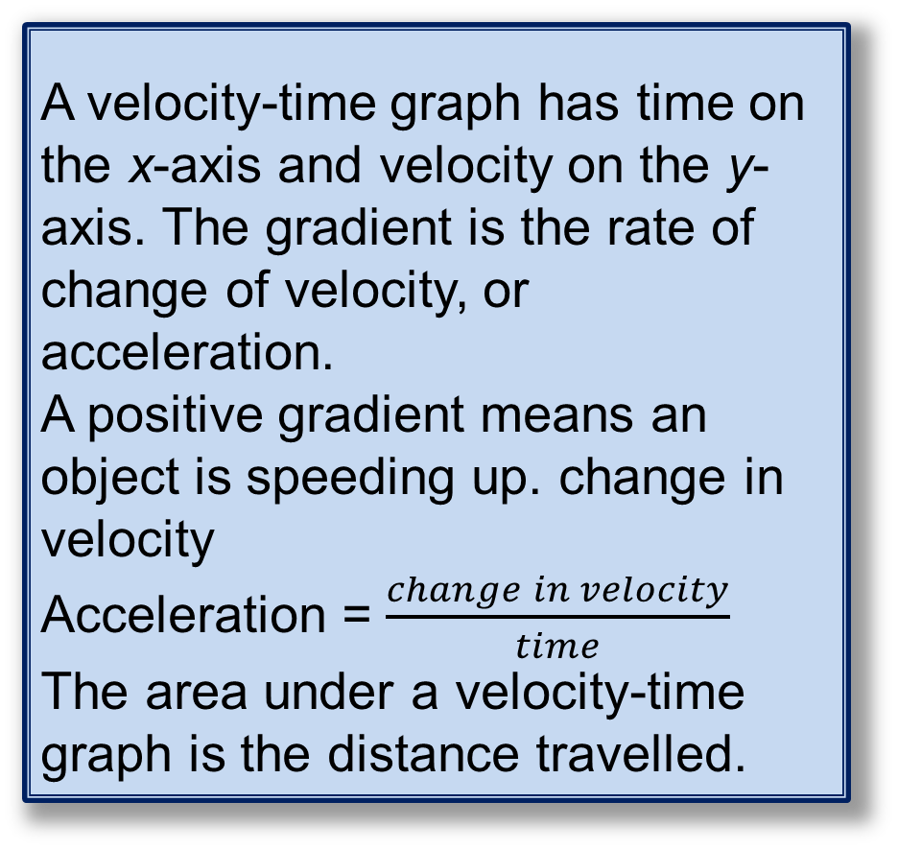
6.3 – Graphing Rates of Change
Page 169
Key Point 9
A velocity-time graph has time on the x-axis and velocity on the y-axis. The gradient is the rate of change of velocity, or acceleration.
A positive gradient means an object is speeding up. change in velocity
Acceleration = $\frac{change in velocity}{time}$
The area under a velocity-time graph is the distance travelled.

Slide 47

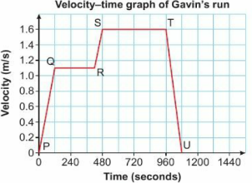
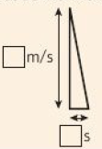
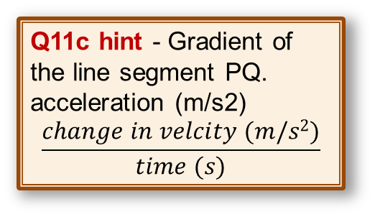
6.3 – Graphing Rates of Change
Page 170
Real Gavin goes
for a run. The graph
shows his journey.
Work out:
  Gavin's maximum
  velocity
  how many minutes
  he ran at 1.1 m/s
  his acceleration for the first part of the journey
  the distance Gavin ran during the last 120 seconds.
  Copy and complete this description of Gavin's run.
  He accelerated at ◻ m/s2 for the first ◻ minutes, then ran at a constant velocity of ◻ m/s for ◻ minutes. Next...
Q11b hint - Read
seconds from the graph
and change to minutes.
Q11c hint - Gradient of the line segment PQ. acceleration (m/s2)
$$\frac{change in velcity (m/s2)}{time (s)}$$
Q11d hint - Find the area of the triangle under the line segment
TU.
Read the
height from
the velocity
axis and the
base from
the time axis.
Communication hint - Deceleration is negative acceleration. It means that an object is slowing down.

Slide 48
6.3 – Graphing Rates of Change
Page 170
Discussion How do you show constant speed, constant acceleration and constant deceleration on a velocity-time graph?
Reflect Why do we call the graphs in this lesson 'rate of change‘ graphs?
What kind of rates of change might you find in everyday life?
Q12 hint - What can you think of that changes?

Slide 49
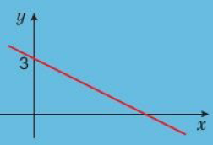
6.4 – Real-life Graphs
Page 166
Objectives |  | Why Learn This?
Draw and interpret real-life linear graphs. Recognise direct proportion. Draw and use a line of best fit. |  | Engineers use graphs showing the performance of car engines to work out the most efficient speeds to save fuel.
Fluency
Here is a sketch of a graph with a gradient of — What is its equation?
ActiveLearn - Homework, practice and support: Higher 6.4

Slide 50

6.4 – Real-life Graphs
Page 171
The table shows the charge for using different numbers of units of electricity,
  Plot these points on a grid,
  i. Use your graph to find the charge for using 800 units of electricity,
    Declan receives a bill for
    £60. How many units of electricity has he used?
Units | 0 | 200 | 500 | 700 | 900 | 1000
Charge (£) | 12 | 40 | 82 | 110 | 138 | 152
Warm Up
Key Point 10
Graph axis do not have to start at zero. A zigzag line shows that values have been missed out.

Slide 51
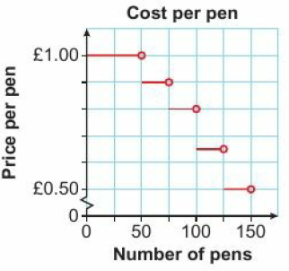
6.4 – Real-life Graphs
Page 171
Real / Problem-solving Gurpreet is buying some pens to give away at an exhibition.
The graph shows the price per pen depending on how many pens are ordered,
  How much would a single pen cost?
  Gurpreet buys 60 pens. How much does he spend altogether?
  For another event, Gurpreet is given a budget of £75. How many pens can he afford to buy?
Q2 hint - The open circles show that the upper limit of each bar is not included at that price.

Slide 52
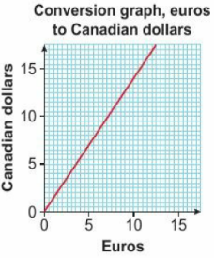
6.4 – Real-life Graphs
Page 171
Finance/Reasoning
This graph shows
the conversion from
euros (€) to
Canadian dollars
(C$).
  How many dollars do you get for €10?
  How many euros do you get for C$1?
  Work out the gradient of the graph.
  Discussion What does the gradient tell you?

Slide 53
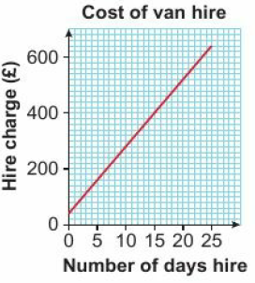
6.4 – Real-life Graphs
Page 171
Real / Reasoning - This graph shows the charge to hire a van for a number of days,
  Calculate the gradient of the line,
  What is the initial charge before you add on the daily hire charge?
  Write down the equation of the line.
  Discussion What does each part of the equation represent?
  Alice has £450. For how many days can she hire the van?
Key Point 11
When two quantities are in direct proportion
their graph is a straight line through the origin
when one variable is multiplied by n, so is the other.

Slide 54
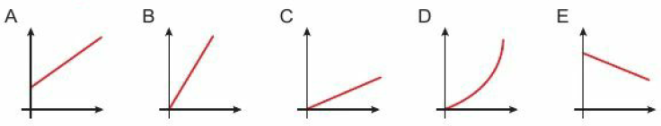
6.4 – Real-life Graphs
Page 172
Modelling Which of these graphs show one variable in direct proportion to another?
Modelling Look at the graph you drew for Q1, and the graphs in Q3 and Q4. Which show direct proportion?

Slide 55
6.4 – Real-life Graphs
Page 172
Real / Reasoning - A recipe uses a spice mix including chilli powder and cumin in the ratio 2:5.
  Copy and complete this table.
  Draw a graph showing grams of cumin (y) against grams of chilli (x).
  Write the equation Linking x and y.
  How much chilli would you need for a recipe using 85g of cumin?
  Discussion Does extending the graph give accurate values?
Chilli powder (grams) | 1 | 4 | 10
Cumin (grams)
Q7c hint – You could write the equation of the line.
Q7d hint – How can you use the values in the table to help you?

Slide 56
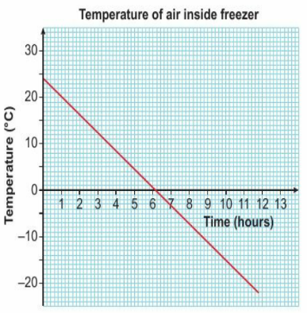
6.4 – Real-life Graphs
Page 172
Reasoning / Modelling Zadie has a new freezer delivered to her house.
Zadie turns on the freezer and a sensor records the temperature inside the freezer. The graph gives information about the temperature, T°C, of the air inside the freezer.
  What does the y-intercept tell you? What does the x-intercept tell you?
  Use the graph to estimate the temperature 3.5 hours after Zadie turns on the freezer,
  How much does the temperature fall over the first 5 hours?
  Is the rate of decrease of temperature constant? How can you tell from the graph?
  Discussion Can you predict the temperature when x = 14? When x = 36?

Slide 57
6.4 – Real-life Graphs
Page 173
Reasoning / Modelling - The table shows the largest quantity of a sugar, k grams, which will dissolve in a cup of coffee at temperature t°C.
  On a suitable grid, plot the points and draw a graph to illustrate this information,
  Use your graph to find
    the lowest temperature at which 120 g of sugar will dissolve in the coffee
    the largest amount of sugar that will dissolve in the coffee at 81 °C.
  The equation of the graph is in the form k= at+b.
  Use your graph to estimate the values of the constants a and b. d Will 4 teaspoons of sugar dissolve in the coffee at 90 °C?
  Use the equation to decide. Justify your answer.
t (⁰C) | 44 | 50 | 62 | 70 | 78 | 85
K (grams) | 265 | 300 | 360 | 400 | 440 | 475
Q9d hint - 1 teaspoon of sugar = 5 grams

Slide 58
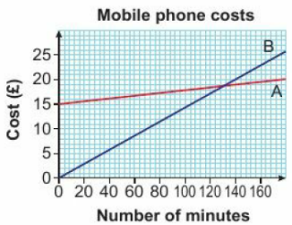
6.4 – Real-life Graphs
Page 173
Reasoning / Finance - The graph shows two different Pay As You Go mobile phone tariffs, Plan A and Plan B.
  How much does 100 minutes cost on
    Plan A ii. Plan B?
  What is the practical meaning of b the y-intercept value on Plan A
  the point where the two graphs intersect?
  Another tariff. Plan C, is introduced. On Plan C you will pay £18.50 per month for unlimited minutes.
  Which plan should each person choose?
  Molly: Average 150 minutes of calls per month.
  Theo: Average 100 minutes of calls per month.

Slide 59
6.4 – Real-life Graphs
Page 173
Finance / Real / Reasoning Beth wants to sell her car.
She has tracked the online sale price of the same model of
car for a month. Here are her results.
  Plot a scatter graph of Beth's results,
  What type of correlation does this graph show?
  Draw in a line of best fit.
  Write the equation of your line of best fit.
  Beth’s car is 3½ years old.
  Use your equation to work out how much she should sell it for.
Discussion - Can you use your equation to predict the price of a brand new car?
Car age (years) | 1.1 | 3 | 3 | 5 | 4.2 | 1.7 | 5.5 | 2.5
K (grams) | 11800 | 9000 | 10250 | 4900 | 6000 | 10700 | 4500 | 9800
Q11a hint - Plot years against price in £1000s.

Slide 60
6.4 – Real-life Graphs
Page 173
12 – Exam-Style Questions
The table shows life expectancy (in years) for females born in the UK from 2000 to 2013.
From this data, work out the life expectancy of a girl born in
  i 2020
  ii 2050. (4 marks)
Which answer is more reliable?
Why? (2 marks)
Year of Birth | Life Expectancy
2000 | 80.2
2001 | 80.4
2002 | 80.5
2003 | 80.5
2004 | 81.1
2005 | 81.2
2006 | 81.5
2007 | 81.7
2008 | 81.7
2009 | 81.7
2010 | 82.3
2011 | 82.6
2012 | 82.8
2013 | 83.0
Q12 strategy hint - You could draw a graph to show this information and extend it

Slide 61

6.5 – Line Segments
Page 166
Objectives |  | Why Learn This?
Find the coordinates of the midpoint of a line segment. Find the gradient and length of a line segment. Find the equations of lines parallel or perpendicular to a given line. |  | Parallel and perpendicular lines are useful for drawing constructions and working out angle question.
Fluency
Which pairs of lines are parallel and which are perpendicular? What can you say about graphs of parallel lines?
ActiveLearn - Homework, practice and support: Higher 6.5

Slide 62
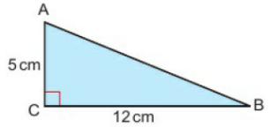

6.5 – Line Segments
Page 174
What is the value halfway between
  5 and 9 b. -2 and 4
  3 and 8 d. -5 and -2?
Here is a right-angled triangle. What is the length of side AB?
Write down the gradient and y-intercept of the line y = 2x - 3
Warm Up
Q2 hint - Use Pythagoras'
theorem.
Q3 hint - Look back at lesson 6.1 if you are stuck.

Slide 63
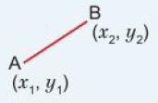
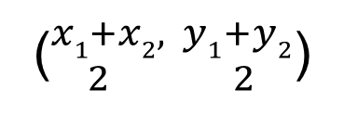
6.5 – Line Segments
Page 175
Work out the midpoint of a line segment AB, where
  A is (0,3) and B is (4,7)
  A is (2,9) and B is (9,2)
  A is (3,8) and B is (-1,6)
  A is (-4,-1) and B is (0,0).
Discussion How can you find the midpoints of line segments without drawing?
Q4 hint - Draw the
lines on a grid with axes from -10 to 10.
Q4 communication hint – A line segment is a part of a straight line.
Q4 discussion hint – What value is half way between the two x-coordinates? And between the two y-coordinates.
Key Point 12
The coordinates of the
midpoint of a line segment
are:
(${x1+x2, y1+y2 \atop 2 2}$)

Slide 64

6.5 – Line Segments
Page 175
Work out the midpoint of a line segment PQ, where
  P is (0,1) and Q is (3,10)
  P is (2,3) and Q is (6, -5)
  P is (-3,3) and Q is (7,-2)
  P is (-7, -4) and Q is (5,0).
Work out the gradient of each line segment in Q5.
Q5 hint - Work out these midpoints without drawing the graphs.
You can use a quick sketch to check your answer after you have worked it out.
Q6 hint - Use the formula:
gradient = $\frac{change in y}{change in x}$ or m = $\frac{y2 −y1}{x2 −x1}$

Slide 65

6.5 – Line Segments
Page 175
What is the length of the line segment with end points
  E (-3, 2) and F (0, -2)
  G (-4, -1) and H (2, 7)
  J (-5,3) and K (8, -1)?
Q7a hint - Sketch
a right-angled
triangle and use
Pythagoras‘
theorem to work
out the length of
the hypotenuse.

Slide 66

6.5 – Line Segments
Page 175
Reasoning A line is parallel to the line
y = 2x - 7 and passes through the point (2, -5).
  Substitute the value of m for this line into y = mx + c.
  Substitute the coordinates of the known point to work out the equation of the line.
Reasoning / Finance The graph shows the profits of two companies who sell garden furniture. Write the equation for the profit of company B.

Slide 67

6.5 – Line Segments
Page 176
Problem-solving Write the equation of a line parallel to
y = x + 2, which passes through the point (9, -2).
Problem-solving Find the equation of a line that passes through the point (-2, -2) and is parallel to the line with equation y - 3x = 7.
Write down the gradient of a line perpendicular to
  y = 3x - 1 b. y= ¼x + 2.
  y = $\frac{2}{5}$x + 3

Slide 68


6.5 – Line Segments
Page 176
Here are three pairs of perpendicular lines,
  Write down the gradient of each line,
  Multiply the gradients in each pair together. What do you notice?
Key Point 13
When two lines are perpendicular, the product of the gradients is -1. When a graph has gradient m, a graph perpendicular to it has gradient: $\frac{−1}{m}$

Slide 69
6.5 – Line Segments
Page 176
14 – Exam-Style Questions
Find the equation of a line
that is perpendicular to the line with equation
y = ½x and passes through the point (-2, 9) (2 marks)
that is perpendicular to the line with equation x + y = 6 and passes through the point (-3, -7). (2 marks)

Slide 70
6.6 – Quadratic Graphs
Page 176
Objectives |  | Did You Know?
Draw quadratic graphs. Solve quadratic equations using graphs. Identify the line of symmetry of a quadratic graph. Interpret quadratic graphs relating to real-life situations. |  | Quadratic graphs help us work out the path followed by projectiles as they move through the air, like footballs or juggling balls
Fluency
Which of these are quadratic expressions? x³ + x² • 4x + 2 • 1 - x² • 5x² - 6x + 1
ActiveLearn - Homework, practice and support: Higher 6.6

Slide 71

6.6 – Quadratic Graphs
Page 177
Write down the equation for each line.
Copy and complete the table of values for y = x²
Warm Up
x | -4 | -3 | -2 | -1 | 0 | 1 | 2 | 3 | 4
y

Slide 72
6.6 – Quadratic Graphs
Page 177
Plot the graph of y = x² using your table of values from Q2.
Draw an x-axis from -5 to +5 and a y-axis from 0 to +20.
Plot the coordinates from your table of values.
Join the points with a smooth curve.
Label your graph y = x².
Q3 strategy hint - It is easier to draw a curve with your hand 'inside it' and moving outwards. Turn your paper round so you can draw the curve comfortably.
Key Point 14
A quadratic equation contains a term in x² but no higher power of x. The graph of a quadratic equation is a curved shape called a parabola.

Slide 73
6.6 – Quadratic Graphs
Page 177
a. Copy and complete this table of values for y = x² - 3.
  Plot the graph of y = x2 - 3.
Discussion What do you think the graph of y = x² + 2 will look like?
x | -3 | -2 | -1 | 0 | 1 | 2 | 3
x²
-3 | -3 | -3 | -3 | -3 | -3 | -3 | -3
y
Q4a hint - For quadratic functions with more than one step, you can include a row for each step in the table.

Slide 74


6.6 – Quadratic Graphs
Page 177
5 – Exam-Style Questions
Draw the graph of y = -x² for -3 ≤ x ≤ 3. (4 marks)
Q5 strategy hint - Work out the value of y for all the integer values of x from -3 to 3.
You could draw a table for these values.
Exam hint
Here are some
common mistakes
people make
when drawing
graphs:

Slide 75

6.6 – Quadratic Graphs
Page 177
a. Copy and complete this table of values for y = 3x²
  Plot the graph of y = 3x².
x | -2 | -1 | 0 | 1 | 2
y
Key Point 15
A quadratic graph has either a minimum point or a maximum point where the graph turns.

Slide 76
6.6 – Quadratic Graphs
Page 178
Reasoning Compare your graphs from Q3, Q4, Q5 and Q6.
  What is the same about these graphs?
  Which ones have a minimum point? Which ones have a maximum point?
  Find the coordinates of the minimum/maximum point for each graph,
  Describe the symmetry of each graph by giving the equation of its mirror line.

Slide 77

6.6 – Quadratic Graphs
Page 178
Modelling / STEM Some maths students are investigating the effects of gravity on bottle rockets.
The students measure the rocket's height until it falls back to the ground.
The graph shows the rocket’s height, h metres, at time t seconds after take-off.
  What type of graph is this?
  When is the rocket travelling fastest?
  When is the rocket's speed zero?
  What is the maximum height that the rocket reaches?
  Flow long is the rocket in the air?

Slide 78

6.6 – Quadratic Graphs
Page 178
Here is the graph of y = x² - 1. Use the graph to solve the equation x² -1 = 0.
Discussion Flow could you use the graph to solve x2 - 1 = 2?
Key Point 16
A quadratic equation can have 0, 1. or 2 solutions

Slide 79




6.6 – Quadratic Graphs
Page 178
Here are four graphs. Use these graphs to solve the equations
  2x-x2= 0
  x² -2x + 1 = 0
  2x² + 5x -3 = 0
  6 - x² - x = 0

Slide 80

6.6 – Quadratic Graphs
Page 179
Example 3
Here is the graph of y = x² – 3x - 2.
Use the graph to solve the equation x² – 3x – 8 = 0.
Give your answer correct to 1 decimal place.
x² – 3x – 8 = 0
+ 6 + 6
x² – 3x – 2 = 6
x = -1.7
x – 4.7
Rearrange the equation so that one side is x² – 3x - 2
Find where y = x² – 3x – 2 intersects y = 6
-8 + 6 = -2
Read off the x-values

Slide 81

6.6 – Quadratic Graphs
Page 179
Reasoning Use the graphs in Q10 to solve the equations
  2x - x² + 2 = 0
  x² - 2x - 3 = 0
  2x² + 4x - 3 = 0
  1 - x² - 3x = 0
  Explain why 2x - x² = 3 has no solutions.
Q11c hint –

Slide 82

6.6 – Quadratic Graphs
Page 179
12 – Exam-Style Questions
Complete the table for
y = 2x² - 3x - 4. (2 marks)
Draw the graph of y = 2x² - 3x- 4. (2 marks)
By drawing a suitable line on your graph, solve the equation 2x² + x - 20 = 0. (2 marks)
x | -2 | -1 | 0 | 1 | 2 | 3 | 4
y |  | 1 |  |  | -2 | 5
Q12
strategy
hint

Slide 83

6.6 – Quadratic Graphs
Page 179
Modelling / Real Carla throws a rounders ball.
This table gives data for the height, h metres, of the rounders ball at time, t seconds, after Carla has thrown it.
  Use this data to draw a graph showing the trajectory of the rounders ball,
  Continue the graph to predict when the rounders ball will land.
Time t (seconds) | 0 | 1 | 2 | 3 | 4
Height h (metres) | 1.2 | 3.7 | 4.7 | 4.2 | 2.2
Q13 communication hint - The trajectory of an object is the path it follows

Slide 84
6.7 – Cubic and Reciprocal Graphs
Page 180
Objectives |  | Why Learn This?
Draw graphs of cubic functions. Solve cubic equations using graphs. Draw graphs of reciprocal functions. Recognise a graph from its shape. |  | You may see reciprocal graphs in science, when you do experiments on volume and pressure.
Fluency
What shape is: A linear graph • A quadratic graph
ActiveLearn - Homework, practice and support: Higher 6.7

Slide 85

6.7 – Cubic and Reciprocal Graphs
Page 180
Copy and complete this table of values for y = x³
Work out the value of $\frac{1}{x}$ when:
  x = -4 b. x = $\frac{1}{3}$
Warm Up
x | -3 | -2 | -1 | 0 | 1 | 2 | 3
y
Key Point 17
A cubic function contains a term in x³ but no higher power of x. It can also have terms in x² and x and number terms.

Slide 86

6.7 – Cubic and Reciprocal Graphs
Page 180
Using your table of values from Q1, draw the graph of y = x³ for
-3 ≤ x ≤ 3
Reasoning Use your graph from Q3 to estimate
    1.7³ b. $\sqrt[3]{−11}$
    Use a calculator to work out
    1.7³ d. $\sqrt[3]{−11}$
Discussion Which of your answers are most accurate? Explain.
Q3 hint - What values do you need to include on the x-axis? And on the y-axis.

Slide 87

6.7 – Cubic and Reciprocal Graphs
Page 180
Draw the graph of y = -x³ for -3 ≤ x ≤ 3.
Reflect What is the same and what is different about this graph and the one you drew in Q3?
Q5 hint - Make a table of values like the one in Q1.
Key Point 18
A reciprocal function is in the form $\frac{k}{x}$ where k is a number.

Slide 88
6.7 – Cubic and Reciprocal Graphs
Page 180
a. Plot graphs of y = x³ + 1 and y = x³ - 2 for -3 ≤ x ≤ 3.
  Compare these two graphs and the graphs from Q3 and Q5.
  What similarities can you see? What are the differences?
  Discussion What do you think the graph of y = x³ + 5 would look like? What about y = x³ - 1?
Q3 hint - Draw both graphs on the same axes

Slide 89



6.7 – Cubic and Reciprocal Graphs
Page 181
Example 3
Draw the graph of y = $\frac{1}{X}$ where x ≠ 0, for -3 ≤ x ≤ 3.
Make a table with x-values from -3 to 3. Do not include 0.
x | -3 | -2 | -1 | -½ | -¼ | ¼ | ½ | 1 | 2 | 3
y | -$\frac{1}{3}$ | -½ | -1 | -2 | -4 | 4 | 2 | 1 | ½ | $\frac{1}{3}$
Work out the y-values and complete the table
Plot the points, join the two parts with smooth curves.
Discussion – Why can’t you read the value of y when x = 0 from this graph.

Slide 90

6.7 – Cubic and Reciprocal Graphs
Page 180
Reasoning a. Draw a table of values for y = - $\frac{1}{x}$ where x ≠ 0, for -3 ≤ x ≤ 3.
  Draw the graph of y = - $\frac{1}{x}$.
  What is same and what is different about y = $\frac{1}{x}$ and y = - $\frac{1}{x}$?
a. Draw the graph of y = $\frac{3}{x}$, where x ≠ 0, for -4 ≤ x ≤ 4.
  Use your graph to find the value of y when
    x = 3 ii. x = -1 iii. x = -2.5

Slide 91



6.7 – Cubic and Reciprocal Graphs
Page 181
Reasoning Match each equation to a graph.
  y = x² - 1 b. y = x² - 2.
  y = 2x d. y = $\frac{1}{x}$
  y = -x³ f. y = -3x

Slide 92
6.7 – Cubic and Reciprocal Graphs
Page 181
Key Point 20
A cubic equation can have 1, 2 or 3 solutions.
Reflect Write a hint on how to remember the shapes of different types of graphs. Include sketches in your hints.
Use the graphs you drew in Q6 to solve the equations.
  x³- 2 = 0 b. x³ + 1 = 0
  x³ - 2 = -3
Q11c hint - Read off the x-values where the curve crosses y = -3.

Slide 93
6.7 – Cubic and Reciprocal Graphs
Page 182
12 – Exam-Style Questions
Complete the table of values for
y = x3 - 5x. (2 marks)
Draw the graph of y = x³ - 5x from x = -3 to x = 3. (2 marks)
Hence or otherwise, solve
x³ - 5x = 2. (2 marks)
Nov 2013, Q17, 1MA0/2H
x | -3 | -2 | -1 | 0 | 1 | 2 | 3
y |  |  | 4 | 0 |  |  | 12
Exam hint
Think, about what shape your graph should be. About where will it cross the axes? In part e, 'Hence or otherwise' means that it will be easier to answer this question using parts a and b (the graph you have drawn

Slide 94

6.7 – Cubic and Reciprocal Graphs
Page 181
This is the graph of y = 11x + 2x² - 5x³.
By drawing suitable lines on the graph
  solve the equation 11x +2x²-5x³ = 0
  solve the equation
  11x + 2x² - 5x³ = 8.

Slide 95

6.8 – More graphs
Page 182
Objectives |  | Why Learn This?
Interpret linear and non-linear real-life graphs. Draw the graph of a circle. |  | You can apply all the things you have learned about graphs to many interesting and practical contexts that you often come across in daily life.
Fluency
These graphs show how the depth of water in two containers changes over time, when you pour water in at a steady rate. Which container fills with water faster?
ActiveLearn - Homework, practice and support: Higher 6.8

Slide 96

6.8 – More graphs
Page 182
From the graph, find
  the value of x when y = 3
  the value of y when x = 1.
Construct a circle of radius 5cm.
Warm Up

Slide 97


6.8 – More graphs
Page 183
Reasoning / Modelling The distance-time graphs represent the journeys made by a bus and a car starting in Exeter, travelling to Cheltenham and returning to Exeter,
  How far is it from Exeter to Cheltenham?
  Including stops, how much longer than the car did the bus take to complete the journey from Exeter to Cheltenham?
  Work out the greatest speed of the car during the journey.
  The bus stopped at Weston-super-Mare on its journey.
  On the return journey, at what time did the bus reach Weston-super-Mare?
  Work out the average speed of the car over the whole journey.
  What does the charge in gradient on the bus's journey from Weston-super-Mare to Cheltenham show?
Q3e hint - Include
the stops.

Slide 98


6.8 – More graphs
Page 183
Modelling / STEM A skydiving instructor jumps from an aircraft flying at 3000 m.
The graph models her motion as she falls.
At what height does she open her parachute? Explain how you know.
Q4 hint When does she start descending at a constant speed?
Key Point 21
No correlation or weak correlation shows that there is no linear relationship between two quantities, because their graph is not close to a straight line.
When the points follow a curve, there may be a non-linear relationship between the quantities.

Slide 99
6.8 – More graphs
Page 183
Reasoning Here are two sets of data.
Data Set A
Data Set B
  Plot each set of data on a scatter graph,
  Describe the correlation for each set.
  Draw a line of best fit for the graph for data set A. What does this show?
  Draw the graph of y = x² on the same grid as the graph for data set B. Copy and complete this table of values to help you.
  What do you notice from your graph? What do you think the relationship is between x and y in data set B?
x | 3 | 4 | 5 | 6 | 7 | 8 | 9 | 10
y | 7 | 8 | 10 | 13 | 14 | 16 | 16 | 21
x | 3 | 3.6 | 4 | 4 | 4.5 | 4.7 | 5.1 | 5.3 | 5.6 | 5.7
y | 9 | 13 | 15 | 14 | 21 | 23 | 26 | 27 | 31 | 22
x | 3.0 | 3.2 | 3.5 | 3.7 | 4.0 | 4.8 | 5.0 | 5.5 | 6.0
y
Q5 hint For the graph of data set B, make sure your y-axis extends to 40.

Slide 100
6.8 – More graphs
Page 184
Real / Reasoning The petrol consumption of a car, in
kilometres per litre (km//), depends on the speed of the car.
The table gives some information about the petrol consumption of a car at different speeds.
  Draw axes on graph paper, using 5cm to represent 20km/h on the horizontal axis and 4 cm to represent 1 km// on the vertical axis.
  Start the horizontal axis at 60 and the vertical axis at 12.
  Show the discontinuities clearly on the axes.
  Plot the values from the table and join them with a smooth curve.
  From your graph, estimate
  the petrol consumption at 75 km/h
  the speeds which give a petrol consumption of 13.5 km/t.
Speed (km/h) | 62 | 68 | 76 | 86 | 93 | 99 | 103
Petrol consumption (km//) | 12.6 | 13.9 | 14.7 | 15 | 14.6 | 13.7 | 12.2

Slide 101

6.8 – More graphs
Page 184
The graph shows the numbers of rats recorded in a colony.
  How many rats were there at the start of the study?
  Explain how you found your answer to part a.
  Estimate the number of rats at
    3 weeks ii. 5 weeks,
  Describe the change in the number of rats from week 3 to week 5.
Q7d hint - Is it an increase or a decrease? By how much? Write a sentence beginning, The number of rats…

Slide 102

6.8 – More graphs
Page 184
STEM / Reasoning The graph shows the count rate against time for magnesium-27, which is a radioactive material.
The count rate
is the number
of radioactive
emissions per
second.
  Estimate the count rate after 20 minutes,
  After how many minutes is the count rate 30?
  Estimate the half-life of magnesium-27,
  Does the count rate ever reach zero?
Q8 communication hint - The half-life is the time it takes for the count rate to halve.

Slide 103


6.8 – More graphs
Page 185
Finance / Problem-solving The graph shows the value of an investment over a 5-year period.
  What was the initial
  value of the
  investment?
  Estimate the value
  of the investment
  after 5 years,
  How much did the
  value increase in
  the first year?
  The rate of interest
  remained the same for the 5 years. Work out the percentage interest rate.
Q9d hint - $\frac{actual change}{original amount}$ x 100

Slide 104


6.8 – More graphs
Page 185
Key Point 22
The equation of a circle with centre (0, 0) and radius r is x² + y² = r²
Example 5
Construct the graph of x² + y² = 36
r = $\sqrt{36}$ = 6
Compare x² + y² = 36 with x² + y² = r²
Using compasses set to 6 units, draw a circle, centre 0.
On graph paper, draw the graphs of
  x² + y² = 1 b. x² + y² = 16 c. x² + y² = 49 d. x² + y² = 81

Slide 105
6 – Problem-solving: Profit parabolas
Page 186
Objectives
Use quadratic functions to model real-life situations.
Tom sells trainers online. He has hired you to work out the best (most profitable) price for his trainers. T is the price at which Tom sells each pair of trainers, Q is the quantity (or number) of pairs of trainers that Tom sells per week, and P is Tom's weekly profit.
Finance Tom buys each pair of trainers from the supplier for £25.
Explain why his weekly profit can be modelled using the formula: P = Q(T - 25).
Q1 hint - Start by writing an expression for the profit Tom makes on one pair of trainers.

Slide 106
6 – Problem-solving: Profit parabolas
Page 186
Tom sells trainers online. He has hired you to work out the best (most profitable) price for his trainers. T is the price at which Tom sells each pair of trainers, Q is the quantity (or number) of pairs of trainers that Tom sells per week, and P is Tom's weekly profit.
Tom knows (from experience) that if he sells the trainers at £40 nobody buys them, as they are too expensive.
However, every time he lowers his price by £1, he sells 10 more pairs a week on average.
Show that this can be modelled by the formula:
Q = 10(40 - T)
Q2 hint - Show that when the sale price is £40, no trainers are sold. What happens when the sale price is £39, £38 and so on?

Slide 107
6 – Problem-solving: Profit parabolas
Page 186
Tom sells trainers online. He has hired you to work out the best (most profitable) price for his trainers. T is the price at which Tom sells each pair of trainers, Q is the quantity (or number) of pairs of trainers that Tom sells per week, and P is Tom's weekly profit.
These formulae can be combined as P = 10(40 - T)(T- 25). Expand the brackets to write this new formula in full.
Finance Starting with your new formula, choose an appropriate method to help you find
  the selling price that will maximise profits
  the most profit Tom can make in a week.
Q4 hint - You might choose to plot a graph of profit against selling price. Create a table of values first to help you choose the sea les for your axes.

Slide 108
6 – Problem-solving: Profit parabolas
Page 186
Tom sells trainers online. He has hired you to work out the best (most profitable) price for his trainers. T is the price at which Tom sells each pair of trainers, Q is the quantity (or number) of pairs of trainers that Tom sells per week, and P is Tom's weekly profit.
Finance Tom's supplier raises their price to £26.
How will this affect your result?
Make a prediction and then test it by adjusting the formula for P.
Q5 hint - You will need to change one of the numbers in the formula given in Q3.

Slide 109

6 – Check up
Page 187
6. Check up
Log how you did on your Student Progression Chart
Linear Graphs
Reasoning A line has equation
2x + 3y = 7. Write down the gradient and y-intercept
of the line.
Write down the
equations of
these four
lines.

Slide 110
6 – Check up
Page 187
Draw a graph of the equation
y = -3x - 1. Do not use a table of values.
Without drawing a graph, find the gradient of the line through each pair of points:
  G (-4, 5) and H (4,1)
  P (1, -4) and Q (4, 5)
Reasoning J is the point (2, -5) and K is the point (-3, -1). Work out
  the midpoint of the line segment JK
  the length of the line segment

Slide 111

6 – Check up
Page 187
Reasoning Hamzah goes for a bike ride with his friends. The graph shows the five stages of his journey.
  What is the gradient for the first stage of the bike ride? What does this represent?
  Work out Hamzah's average speed for the whole journey, including any stops,
  On which stage of the journey was he travelling
  fastest?
  Work out his
  speed for
  that stage.

Slide 112

6 – Check up
Page 187
Reasoning Annie buys some cakes from the Kupkake Faktory.
There is a minimum order of three cupcakes. Then there is a fixed price for each cupcake. The graph shows the price structure,
  What does the gradient tell you?
  What does the y-intercept tell you?
  Are x and y
  in direct
  proportion?
  Explain your
  answer.

Slide 113
6 – Check up
Page 187
Reasoning The equation of a line is y = 3x + 1. Work out
  the equation of a line parallel to
  y = 3x + 1 which goes through the point (2, -7).
  the equation of any line perpendicular to y = 3x + 1 that does not share its y-intercept.
ActiveLearn - Homework, practice and support: Higher 6 Check up

Slide 114


6 – Check up
Page 188
Reasoning Match each equation to one of the
graphs below.
  y = x² b. y = $\frac{1}{x}$ c. y = -x² d. x² + y² = 9
  y = x³
  y = - $\frac{1}{x}$
  y = -x³

Slide 115

6 – Check up
Page 188
The equation -x³ + 3x -1 = 0 has three solutions.
Use the graph of y = -x³ + 3x -1 to estimate all three solutions.

Slide 116

6 – Check up
Page 188
Real-Life Graphs
Real / Modelling Hannah is watering her garden.
The water coming out of the hosepipe forms a smooth curve.
This graph models the curve,
  Give the coordinates of the maximum point of this graph.
  What was the maximum height that the water reached?
  How long did the water
  take to hit the ground
  after leaving the
  hosepipe? Time (s)
  What is the practical
  meaning of the start
  point of the graph
  (the y-intercept)?

Slide 117

6 – Check up
Page 189
Reasoning Mike fills these containers with water at a constant rate. Match each container to a graph.
How sure are you of your answers? Were you mostly
Just guessing ☹ Feeling doubtful 😐 Confident ☺
What next? Use your results to decide whether to
strengthen or extend your learning.
Reflect

Slide 118

6 – Check up
Page 189
* Challenge - Design a game where you have to get from the start to the finish, collecting all the gold coins and avoiding all the obstacles.
Design your game within a border.
There must be at least 10 obstacles and 5 gold coins. You cannot touch the borders of your grid to escape your obstacles. Record your moves.
Here are two examples of a possible first move for this game:
Walk 7 units south, or walk 7 units down the line a: = -12.
After everyone has finished Check up, challenge a friend to complete your game in fewer moves.

Slide 119
6 – Strengthen
Page 190
6. Strengthen
Linear Graphs
a. Which of these equations of lines are in the form y = mx + c?
    y = 3x + 1 ii. 2y = 4x + 6
    x + y = 4 iv. y = 2x - 1
    10x + 2y = 1
  Rearrange the other equations in the form y = mx + c.

Slide 120

6 – Strengthen
Page 190
The graph shows four straight-line graphs,
  Which lines have y-intercept (0,1)?
  Which graphs have a positive gradient?
  Which graphs have a negative gradient?
  Which equation matches which line?
    y = x - 3 ii. y = -3x + 1
    y = 2x + 1 iv. y = x + 2
Q2b hint – Positive gradients look like this:
Think uphill
Q2c hint – Negative gradients look like this:
Think downhill

Slide 121

6 – Strengthen
Page 190
Match each graph to an equation:
  y = -2x b. y = 3x – 2
  y = -x +2
On squared paper, draw lines with these gradients:
  4 b. -3 c. ½

Slide 122
6 – Strengthen
Page 190
Draw lines for these equations.
  y = 4x - 3 b. y = -x + 2
  y = ½x
Q5a hint - Identify the intercept from the equation. Mark this on the y-axis first.
Then draw the gradient. Use Q4 to help you.
Q5b hint - -x means ‘-1 lot of x'.
Q5c hint - What does it mean if there is not a number on the end of the equation?

Slide 123


6 – Strengthen
Page 191
The sketch graph shows the points A (-3,1) and B (2,6). From the sketch, work out
  the change in x
  the change in y
  the gradient of this line segment, using $\frac{change in y}{change in x}$

Slide 124
6 – Strengthen
Page 191
Work out the gradient of the line segment between each pair of points.
  C (-2, 3) and D (1, 5)
  E (-4, -1) and F (0, 4)
For the same pairs of points as Q7, and the length of each line segment. Leave your answers in surd form.
Q7 hint - Use the same method as Q6 Draw a sketch
Q8 hint - Sketch the line segment. Use Pythagoras' theorem.

Slide 125

6 – Strengthen
Page 191
For the same pairs of points as Q7, find the midpoint of each line segment.
(x , y)
C (-2 , 3)
D ( 1 , 5)
M ( ◻ , ◻)
$\frac{(−2 + 1)}{2}$ $\frac{(3 + 5)}{2}$
Find the negative reciprocal of:
  4 b. $\frac{1}{3}$ c. -10 d. -$\frac{3}{5}$
Q9 hint - Copy and complete the calculation to work out the coordinates of M, the midpoint.
Q11 hint - Find the reciprocal. Then change the sign.

Slide 126
6 – Strengthen
Page 191
a. Choosing from these equations, which pairs of lines are parallel?
  Write the equation of another line parallel to each pair.
A y = 2x - 3
B y = -x - 1
C y = -2x
D y = 4 - x
E y = x + 5
F y = 2x + 1
Q10a hint - Which lines have the same gradient? Look for the same value of m in y = mx + c.
Q10a hint - Your line must have the same gradient, but you can use any different value of c.

Slide 127
6 – Strengthen
Page 191
Choosing from the equations, which pairs of lines are perpendicular?
A y = ½x - 3
B y = -2x - 1
C y = -2x + 5
D y = 1 - x
E y = x + 6
F y = ½x + 1
Q12 hint – Which lines have gradients which are negative reciprocals.
Look for one whole number and one fraction (with the same denominator). One gradient needs to be positive and the other needs to be negative.

Slide 128

6 – Strengthen
Page 192
Reasoning – This
is the graph of
y = ½x +4.
    Which of these
    points are on
    this line?
    L (0,4)
    M (3,6)
    N (-5, -10) P (-4, 2)
    Do the points L, M, N and P satisfy the equation?
Q13 communication hint – To 'satisfy the equation' means 'make the equation true'. Substitute the x and y values into the equation - are both sides equal?

Slide 129
6 – Strengthen
Page 192
Reasoning – a. What is the gradient of any line parallel to
y = 3x - 3?
  Write the equation of a line parallel to y = 3x - 3 that goes through (-1,7).
Q14a hint – In the equation
y = mx + c, m is the gradient.
Q14b hint – Substitute the given values of x and y, and the value of m you found in part a into y = mx + c.
Solve to find c.

Slide 130

6 – Strengthen
Page 192
Non-Linear Graphs
Reasoning Enzo makes a table of values and plots the graph of
y=x² + 2.
From the graph, which points do you think are incorrect?
Q1 hint – Which points do not fit the shape of an x² graph? Check if the points fit the equation.

Slide 131

6 – Strengthen
Page 193
Reasoning Shona makes a table of values and plots the graph of y = x³ - 1.
  From the graph, which points do you think are incorrect?
  Now find the incorrect points in Shona's table of values.
  Work out the correct values.
x | -3 | -2 | -1 | - | 1 | 2 | 3
y | -28 | -7 | -2 | -1 | 0 | 7 | -26
Q2a hint – Which points do not fit the shape of an x³ graph?

Slide 132



6 – Strengthen
Page 193
Reasoning Match the words to the graphs and the equations.
a. b. c. d.
Quadratic
Cubic
Reciprocal
Linear
y = x - 2
y = -x² +4
y = -x²
y = $\frac{1}{x}$
y = x² + 1
y = x³ - 2
Q3 hint – Some words match more than one equation or graph. Which two graphs are quadratic? Which is x²? Which is –x²?
Look back at lessons 6.6 and 6.7 to help you.
Do the same for cubic and reciprocal graphs.

Slide 133

6 – Strengthen
Page 193
Real life Graphs
Reasoning Frankie kicks a rugby ball
for a conversion after a try. He kicks the
all from 6 m in front of the goal posts.
The graph shows the path followed by
the rugby ball.
  What type of graph is this?
  Explain your answer.
  What are the coordinates of the
  maximum point?
  What is the value of y when x = 2?
  What is the value of* when y = 3.5?
  What do the negative values of x mean in this context?
  Find the height of the ball as it goes past the posts, The bar on a rugby goal post is set at 3m. Assuming he kicked the ball straight at the goal, has the ball gone over the bar
Q1a hint – Think about the shape of the graph.
Q1b hint – Look carefully at the axes before you read the values.
Q1e hint – Read the question again fora reminder.

Slide 134


6 – Strengthen
Page 194
Reasoning Here are two vases.
  Use the words 'faster' or 'slower' to write sentences about how the water level in these vases changes as they fill up.
  The graphs show the depth of water against time when water pours into the vases at a constant rate.
  Which graph matches which vase?
Q2a hint – You could write a sentence like 'The water level in this vase rises faster first, then slower.'
Q2b hint – The steeper the graph, the faster the rise in water level.

Slide 135

6 – Strengthen
Page 194
Finance – The graph shows the profit made on the sales of light bulbs by the Light Bulbs Company. The line goes through the origin.
  Copy and complete
    25 bulbs = £◻ profit
    £13 profit = ◻ bulbs
    £◻ profit = 175 bulbs
    ◻ bulbs = £4.80 profit
  Describe the relationship between profit and
  the number
  of light
  bulbs sold.

Slide 136
6 – Extend
Page 195
6. Extend
Reasoning Without plotting the graphs, work out which of these functions
  have the same y-intercept
  have the same gradient.
Problem-solving Point L has coordinates (-1, -3). Point M has coordinates (5, 5).
Point M is the midpoint of the line LN.
  What are the coordinates of point N?
  What is the gradient of the line segment LN? Plant diversity at
Discussion Do you need to work out the equation of the line?
y = ½x +4
y + 4x = 8
2y – x = 6
x + y = 3

Slide 137

6 – Extend
Page 195
a. A is the point (-1, 2). B is the point (7, 5). Find the coordinates of the midpoint of AB.
  P is the point (-4, 1).
  Q is the point (1, -3)
  Find the gradient of PQ.

Slide 138

6 – Extend
Page 195
STEM / Real A biologist conducts a study into plant diversity in a nature reserve.
For each plant, he records the average size of the seeds and the number of seeds on the plant.
His results are shown in the graph.
The line of best fit has been drawn in for you.
Write a formula that models the link between seed size and number of seeds in this sample.
Q4 hint - Find the equation of the line of best fit.

Slide 139
6 – Extend
Page 195
Problem-solving A recipe for ratatouille uses aubergines and tomatoes in the ratio 2:5.
  Write an equation showing the relationship between aubergines, a, and tomatoes, t.
  Plot the graph of the equation from
  a = 0 to a = 10.
  Find the gradient of the graph.
Discussion What is the meaning of the gradient in the context of the question?
  Hence or otherwise, work out the quantity of aubergines needed in a recipe that uses 600 g of tomatoes.
Q4 communication hint - 'Hence or otherwise’ tells you to use the information you've already worked out in the question, or any other method you can think of.
Q5 hint - Check your equation by substituting the values from the ratio. Both sides of the equation must have the same value.

Slide 140


6 – Extend
Page 196
Reasoning Here are the cross-sections of three different
concrete-transporter lorries.
A builder empties the lorries by pumping out the concrete from the bottom at a steady rate. Here are three sketch graphs showing the relationship between the depth of the concrete left in the lorry and the number of minutes since the pump was switched on.
Match each lorry with one graph.

Slide 141

6 – Extend
Page 196
a. Communication Show that the equation x² - 3x - 1 = 2x - 1 can be rewritten as x² - 5x = 0.
  Find the equation of the straight line shown,
  Solve the equation
  x² - 5x =0.
Q7 hint - You can solve the equation x² - 5x = 0 by finding the intersection of the graph of y = x² - 3x - 1 with the graph of a different straight line.

Slide 142

6 – Extend
Page 196
a. Copy and complete this table of values for the equation
y = 1 - $\frac{2}{x}$, x ≠ 0.
  Draw the graph of y = 1 - $\frac{2}{x}$ for -3 ≤ x ≤ 3.
  Write the equations of the two asymptotes for this graph.
x | -3 | -2 | -1 | -0.5 | -0.1 | 0.1 | 0.5 | 1 | 2 | 3
y | 1.7 |  | 3 | 5 |  | -19 |  |  |  | 0.3

Slide 143
6 – Extend
Page 196
Modelling A mobility scooter accelerates from rest at a constant rate of 1.2 m/s².
The distance, s, covered by the scooter is given by the formula
s = ½at², where a is the acceleration in m/s² and t is the time in seconds.
  Draw a graph of the distance covered by the scooter for values of t from 0 to 10 seconds.
  What is the distance covered after 4.5 seconds?
  How many seconds does the scooter take to cover 40m?

Slide 144
6 – Extend
Page 197
Write the equation of a line
  parallel to the line 3x + 5y = -10
  parallel to the line 2y - 4x = 5, and which goes through the point (3,7)
  perpendicular to the line 8x + 6y = -1, and which goes through the point (-2,1).
Communication The point D (4, k) lies on the line y = 3x - 5. Show that the point D also lies on the line y = 2x - 1.

Slide 145


6 – Extend
Page 197
Problem-solving A rectangle is made using four straight lines on centimetre squared paper. Three of these lines are shown on the grid.
The point (-4,0) lies on the missing side,
  Work out the equation of the missing side.
  Label the two missing corners
  C (in quadrant 4) and
  D (in quadrant 3).
  Work out the coordinates of corner D.
  Work out the length of the diagonal BD. Give your answer to 1 d.p.
Q11 hint - Make sure you understand quadrant notation.

Slide 146


6 – Extend
Page 197
13 – Exam-Style Questions
ABCD is a square. P and D are points on the y-axis.
A is a point on the x-axis. PAB is a straight line. The equation of the line that passes through the points A and D is y = -2x + 6.
Find the length of PD.
Nov 2012, Q23, IMAO/1H
Q13 strategy hint - You can start by using the equation
y = -2x + 6 to work out where A and D cut the axes.

Slide 147

6 – Extend
Page 197
Reasoning a. Match each equation with its graph.
  Find the equation of the line of symmetry for each graph.

Slide 148




6 – Extend
Page 198
Problem-solving Match each equation with its graph.
  y = x³ – 4x² + 5 b. y = -x³ + 2x² – 3
  y = 3x³ + 2x + 5 d. y = -2x³ + 2x²
Q15 hint – To find the y-intercept, substitute
x = 0.

Slide 149

6 – Knowledge Check
Page 198
6. Knowledge Check
A linear equation generates a straight-line (linear) graph The equation for a straight-line graph can be written as y = mx + c where m is the gradient and c is the y-intercept Parallel lines have the same gradient. To find the y-intercept of a graph, find the y-coordinate where x = 0. To find the x-intercept of a graph, find the y-coordinate where y = 0. To compare the gradients and y-intercepts of two straight lines, make sure their equations are in the form y = mx + c A linear function has a graph that is a straight line A distance-time graph represents a journey, o Straight lines mean constant speed o horizontal lines mean no movement o the gradient is the speed, since average speed = . $\frac{total distance}{total time}$ o Average speed = $\frac{total distance}{total time}$ Make sure your units match The gradient of a straight-line graph is the rate of change
Mastery
Lesson 6.1
Mastery
Lesson 6.1
Mastery
Lesson 6.2
Mastery Lesson 6.3

Slide 150



6 – Knowledge Check
Page 198
6. Knowledge Check
On a velocity-time graph o straight lines mean constant acceleration o horizontal lines mean no change in velocity (i.e. travelling at a constant velocity) change in velocity o the gradient is the acceleration, since acceleration = $\frac{change in velcity}{time}$ o the area under a velocity-time graph is the distance travelled o Graph axes do not have to start at zero. A zigzag line shows that values have been missed out. When two quantities are in direct proportion o the graph is a straight line through the origin o when one variable is multiplied by n, so is the other
The coordinates of the midpoint of a line segment are: (${x1+x2, y1+y2 \atop 2 2}$)
Mastery
Lesson 6.3
Mastery Lesson 6.4
Mastery Lesson 6.5

Slide 151



6 – Knowledge Check
Page 199
6. Knowledge Check
When two lines are perpendicular, the product of the gradients is -1. When a graph has gradient m, a graph perpendicular to it has gradient $\frac{−1}{m}$ Reciprocal functions are in the form $\frac{k}{x}$ where k is a number A quadratic equation contains a term in x² but no higher power of x. The graph of a quadratic equation is a curved shape called a parabola.
Mastery
Lesson 6.5
Mastery Lesson 6.7
Mastery Lesson 6.6

Slide 152


6 – Knowledge Check
Page 199
6. Knowledge Check
A quadratic graph has either a minimum point or a maximum point where the graph turns. A quadratic equation can have 0,1 or 2 solutions. A cubic function contains a term in x³ but no higher power of x. It can also have terms in x² and x and number terms. A cubic function can have 1,2 or 3 solutions.
Mastery
Lesson 6.5
Mastery Lesson 6.6
Mastery Lesson 6.7
Mastery Lesson 6.7

Slide 153
6 – Knowledge Check
Page 199
6. Knowledge Check
No correlation or weak correlation shows that there is no linear relationship between two quantities, because their graph is not close to a straight line. When the points follow a curve, there may be a non-linear relationship between the quantities The equation of a circle with centre (0,0) and radius r is x² + y² = r² In this unit, which was easier: plotting and drawing graphs or reading and interpreting graphs? Copy and complete this sentence to explain why: I find ______________ graphs easier, because ______________________________________
Mastery
Lesson 6.8
Mastery Lesson 6.8
Mastery Lesson 6.8

Slide 154
6 – Unit Test
Page 200
On squared paper, draw the graph y = 2x -1 for -2 ≤ x ≤ 5 (3 marks)
Line segment GH is drawn on centimetre squared paper.
G is the point (-1,7). H is the point (2, -2).
  Find the gradient of the line segment GH.
  Find the midpoint of the line segment GH.
  Find the length of the line segment GH. Give your answer correct to 1 d.p.
  (4 marks)

Slide 155

6 – Unit Test
Page 200
Here is a sketch of a scatter graph.
Describe a the correlation and b the relationship between x and y.
(2 marks)

Slide 156

6 – Unit Test
Page 200
4 – Exam-Style Questions
Elliot went for a cycle ride. He left home at 10am. The travel graph represents part of Elliot’s cycle ride.
At 11 am Elliot stopped for a rest,
How many minutes did he rest?
How far from home was Elliot at
12:30pm?
At 1:15pm Elliot stopped for 30
minutes.
Then he cycled home at a steady
speed. It took him 1 hour 45
minutes to get home,
Complete the travel graph.
(4 marks)

Slide 157

6 – Unit Test
Page 201
A ball bearing rolls down a ramp onto a table.
The graph shows its velocity for the first 20 seconds.
  What was its acceleration in the first 5 seconds?
  How long is the ramp?
  (4 marks)

Slide 158

6 – Unit Test
Page 201
Here is a scatter graph with the line of best fit drawn on.
Work out the equation for the line of best fit.
(2 marks)

Slide 159
6 – Unit Test
Page 201
Reasoning The formula KE = ½mv² gives the kinetic energy (in joules) of an object with mass m kg and velocity vm/s.
  Work out the kinetic energy of a ball with mass 1.5 kg, travelling at 3m/s.
  Draw a graph of KE against v for values of v between 0 and 4 m/s.
  What is the velocity of the ball if its kinetic energy is 9 joules? (5 marks)
Write the equation of a line which is
  parallel to y = 3x +• 2
  parallel to 2y + 5x = 1
  perpendicular to y = -2x + 1 and passes through the point (4, -3).
  (4 marks)

Slide 160

6 – Unit Test
Page 201
Reasoning Here is the graph of a quadratic function,
  What are the coordinates of the minimum point?
  What is the equation of the line of symmetry of the graph?
  Identify the equation of the graph from the options below. Justify your answer.
    y = x² +2
    y = 2x² + 2x
    y = 2x² - 4x (3 marks)

Slide 161
6 – Unit Test
Page 201
a. solve the equation
2x² - 4x = 2
  find the coordinates of the point where the line
  y = x + 1 intersects the given graph. (4 marks)

Slide 162

6 – Unit Test
Page 202
Sample student answers
Whose method do you prefer? Why?
14 – Exam-Style Questions
Debbie drove from Junction 12 to Junction 13 on a motorway. The travel graph shows Debbie’s journey.
Ian also drove from Junction 12 to Junction 13 on the same motorway.
He drove at an average speed of 66 km/hour.
Who had the faster average speed, Debbie or Ian?
You must explain your answer.
(4 marks)
June 2013, QU, 1MA0/1H

Slide 163

6 – Unit Test
Page 202
14 – Exam-Style Questions

